Slide 1
Give me Award.
201603727 허성일 Heo Seongil
201601812 심윤보 Sim YunBo

Slide 2
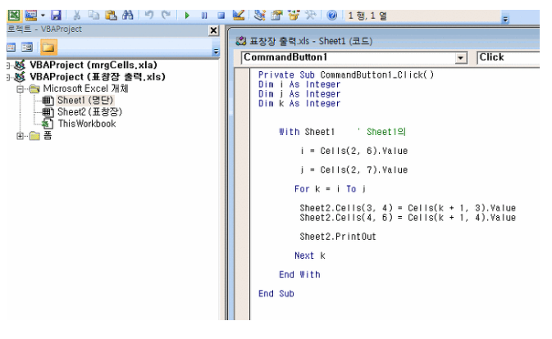
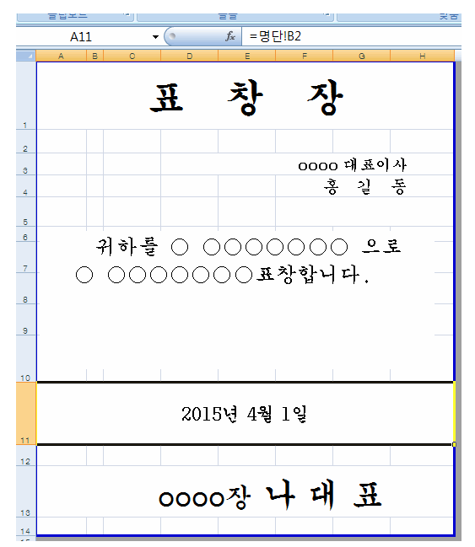
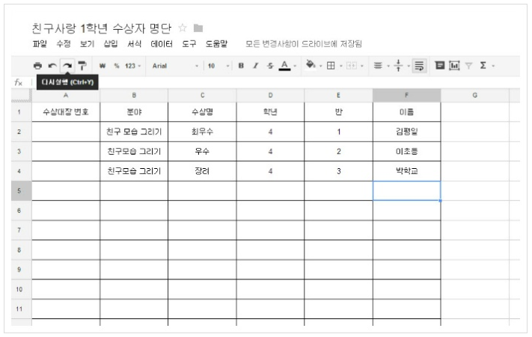
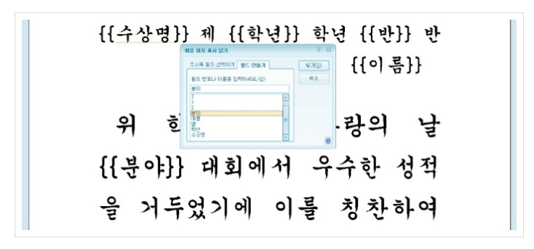
Introduction to Project. 프로젝트 소개
Currently used program
Excel(*.xlsx), Hangeul(*.hwp) etc.
Excel is difficult for beginners to use.
Someone enters information one by one.
In this case, may occur mistakes.

Slide 3
Content .
1. Introduction to Project 프로젝트 소개
2. Main usage techniques 주요 기능
3. Details of each Gui Window 각 스크린 세부사항
〮 Initial Screen : Select menu
〮 First Screen : Input person’s data
〮 Second Screen : Search, Sort and Delete Data
〮 Third Sceen : Select award’s layout image
〮 Fourth Screen : Print for .docx file
4. Results 결과물

Slide 4
Main usage techniques.
Java Swing and Awt gui
Database Mysql
Apache POI & File InputStream/OutputStream
for .docx file input, setting, output

Slide 5
Details of each Gui Window .
각 스크린 세부사항

Slide 6
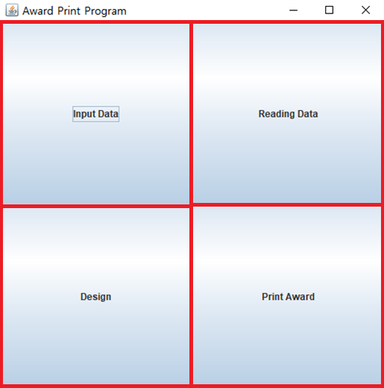
Initial Screen : Select menu
Layout
GridLayout 2 x2
JButton
b1 : Input Data
b2 : Reading Data
b3 : Design
b4 : Print Award
EventHandler
ActionListener
to AnonymousClass
Click the button
to open each window

Slide 7
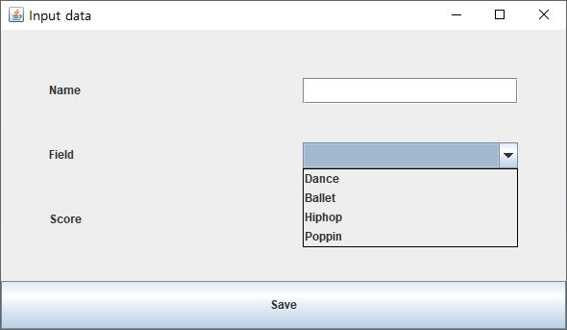
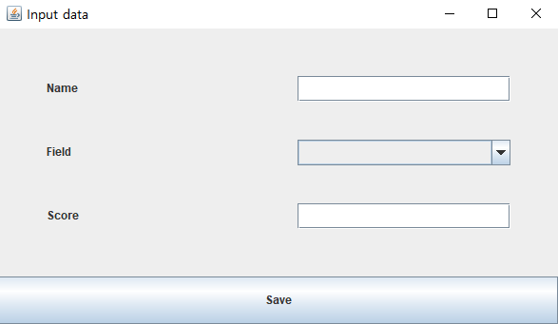
Input person’s data
Layout
BorderLayout
GirdLaout 3 x 2
Button
JLabel , Jtextbox, JCombobox
EventHandler
ActionListener
to AnonymousClass
Click the button
to insert the data to mysql

Slide 8
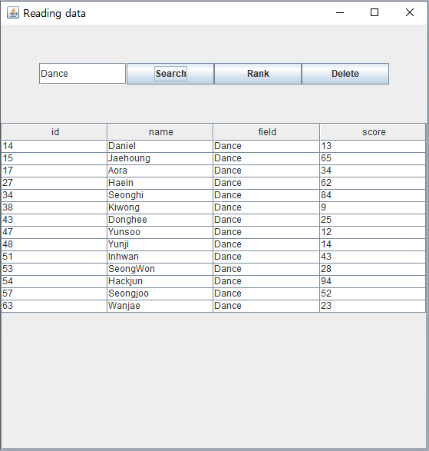
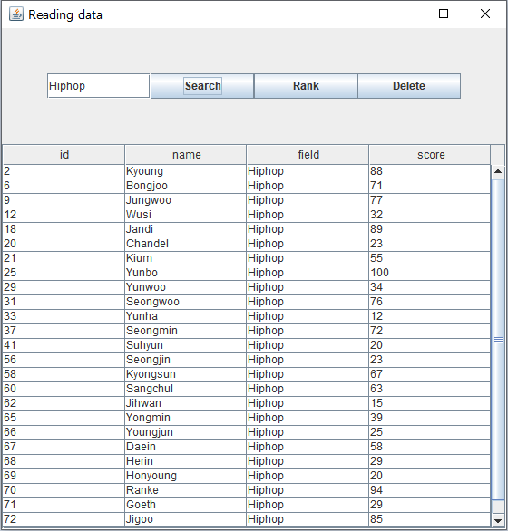
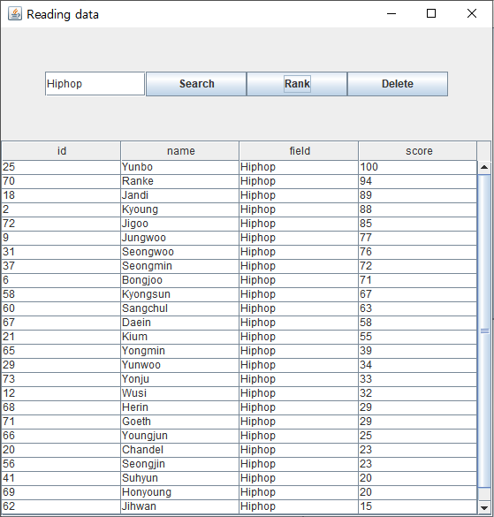
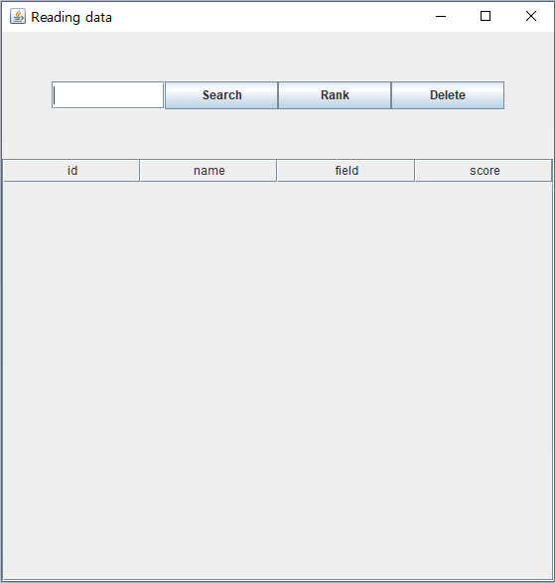
Search, Sort and Delete Data
Layout
BorderLayout
GridLayout 1 x 4
JTextField, Jbutton, JScrollPane
JTable, default table
EventHandler
ActionListener
to AnonymousClass

Slide 9
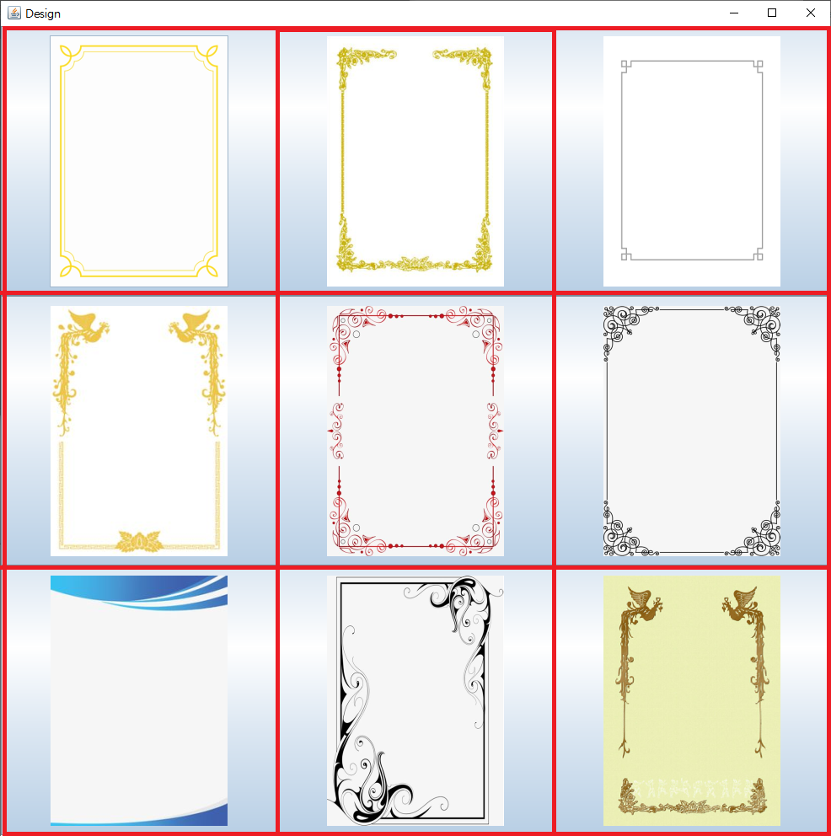
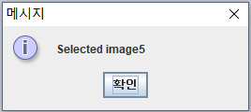
Select award’s layout image
Layout
GirdLayout 3 x 3
Nine Jbutton
ImageIcon
Image
EventHandler
mouseClicked()
to extends MouseAdaterClass
Static int
to memory the image used

Slide 10
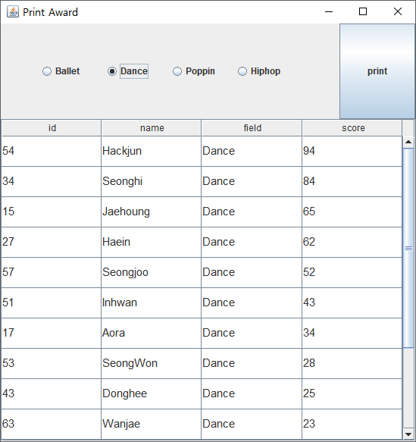
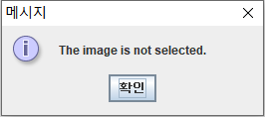
Print for .docx file
Layout
BorderLayout
GridLayout 1 * 4
JRadioButton, JButton, JTable,
JScrollPane
EventHandler
ActionListener to InnerClass & AnonymousClass

Slide 11
Results .
결과물

Slide 12
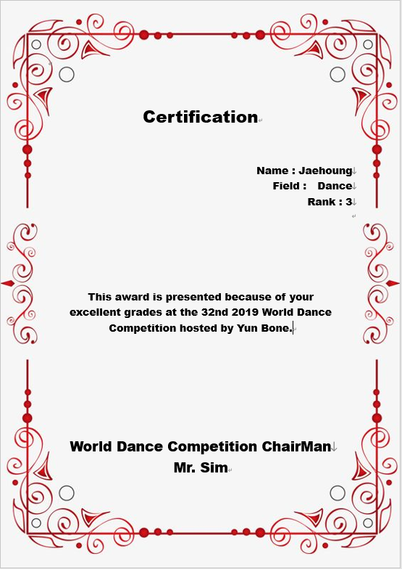
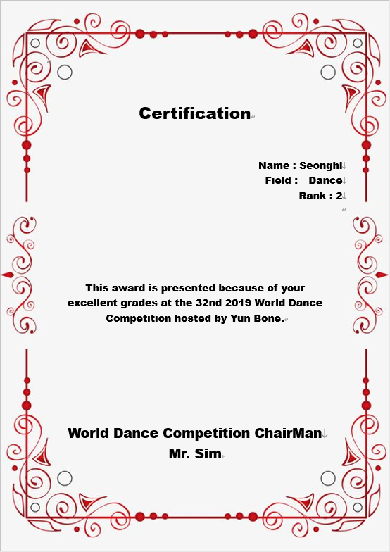

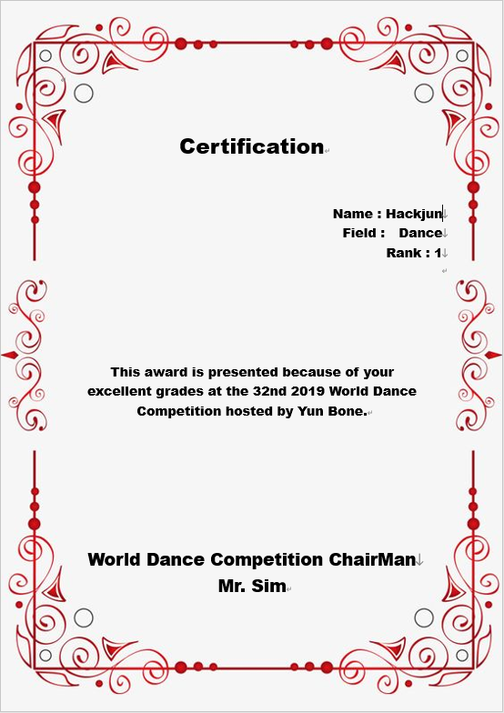
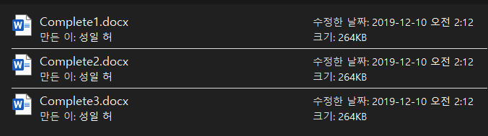

Slide 13
Demo.
END
PPT.

